Slide 1
Lecture-02

Slide 2
Contents
Cloud Computing Architecture
Services Structure
Virtualization
Hypervisor
Virtualizations Architectures
Vmware workstation
Containerization
Containers VS Virtual Machines.

Slide 3
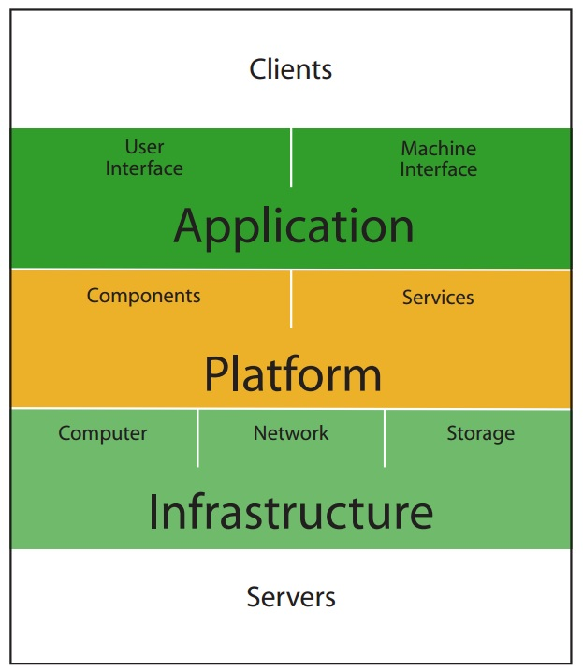
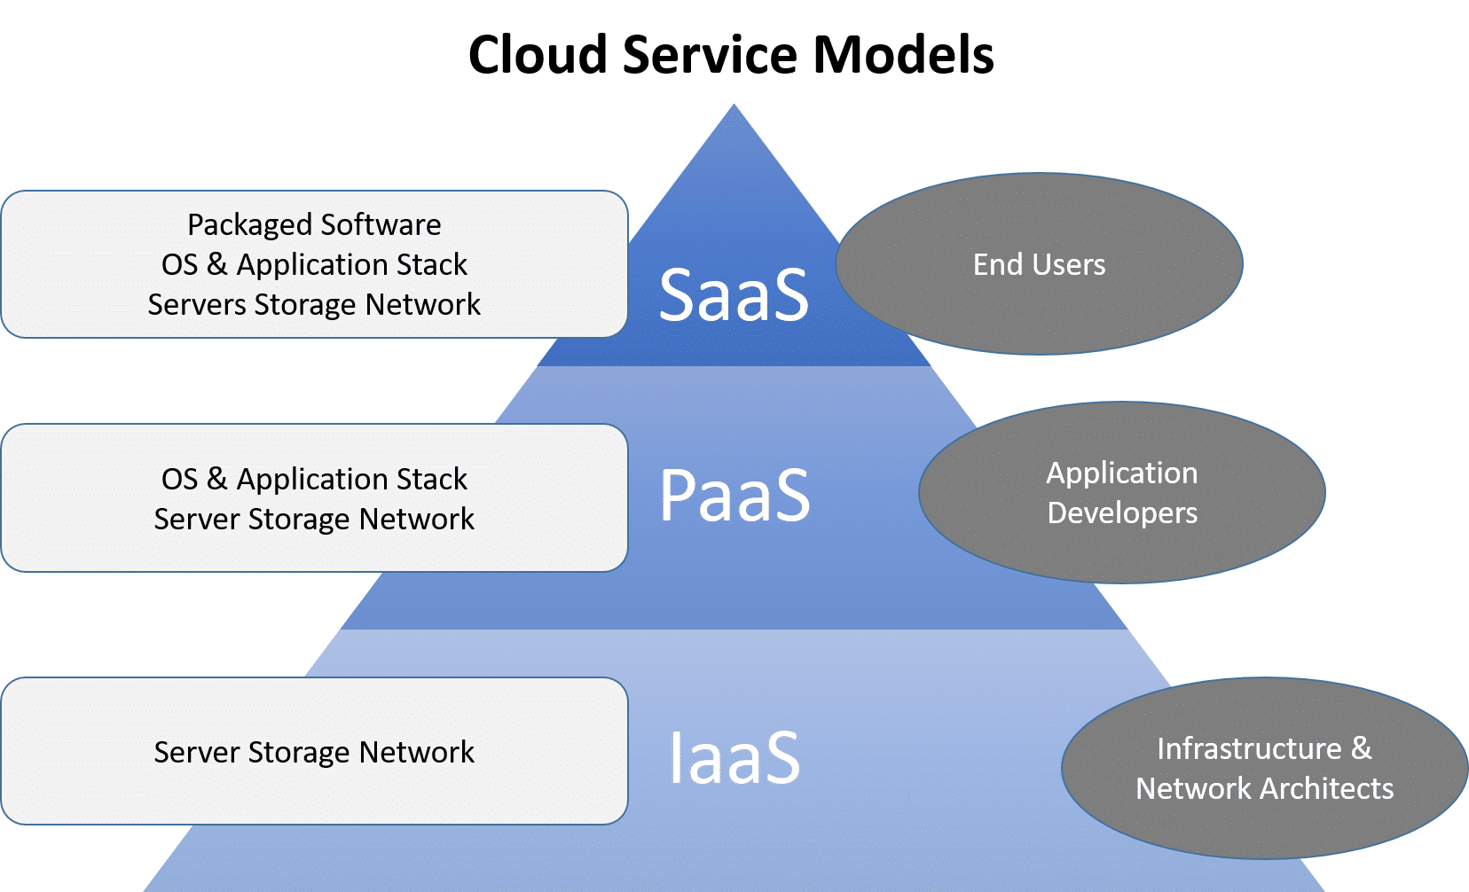
Cloud Computing Services Structure

Slide 4
Cloud Computing Architecture:
Cloud computing architecture are build on service-oriented architecture (SOA) base.
(SOA is a software design where services are provided to the other components by application components, through a communication protocol over a network, they provide interoperability)

Slide 5
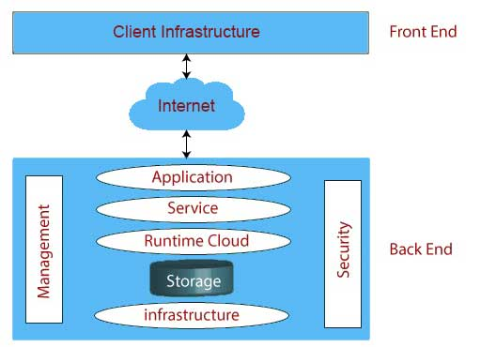
Cloud Computing Architecture (Cont.)

Slide 6
Cloud Computing Architecture (Cont.)
Front End
  Client Infrastructure
    Client Infrastructure refers to the frontend components. It contains the applications and user interfaces which are required to access the cloud platform.

Slide 7
Cloud Computing Architecture (Cont.)
Back End
  The back end is used by the service provider.
Application
Application in backend refers to a software or platform to which client accesses. Means it provides the service in backend as per the client requirement.
Service
Service in backend refers to the cloud based services like SaaS, PaaS, and IaaS. Also manages which type of service the user accesses.
Cloud Runtime
Runtime cloud in backend refers to provide of execution and runtime facilities to the virtual machine.

Slide 8
Cloud Computing Architecture (Cont.)
Storage
Storage in backend refers to provide flexible and scalable storage service and management of stored data.
Infrastructure
Cloud Infrastructure in backend refers to hardware components of cloud like it includes servers, storage, network devices, virtualization software etc.
Management
Back-end components which is used to manage the application, service, runtime cloud, storage, infrastructure, and other security issues in the backend and establish coordination between them.
Security
To implementation of different security mechanisms in the backend for secure cloud resources.

Slide 9
Virtualization
Virtualization is a technology, which creates a layer of abstraction between the applications and the underlying hardware or a host operating system.
OR
Virtualization is a technique, which allows to share a single physical instance of a resource or an application among multiple customers and organizations.
Virtualization has been a big driver in the movement toward the cloud.

Slide 10
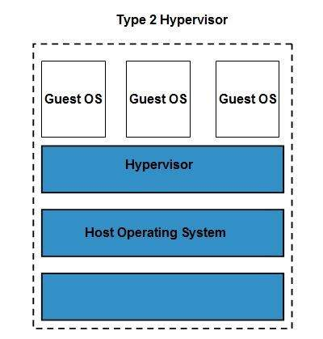
Virtualization (Cont.)

Slide 11
Virtualization (Cont.)
The machine on which the virtual machine is going to create is known as Host Machine and that virtual machine is referred as a Guest Machine.
This virtual machine is managed by a software or firmware, which is known as hypervisor.

Slide 12
Hypervisor
A hypervisor, also known as a virtual machine monitor or VMM.
VMM is a software that creates and runs virtual machines (VMs).
A hypervisor allows one host computer to support multiple guest VMs by virtually sharing its resources, such as memory and processing.
A well-known example of a hosted hypervisor is Oracle VM VirtualBox. Others include VMware Server and Workstation, Microsoft Virtual PC, KVM, QEMU and Parallels.

Slide 13
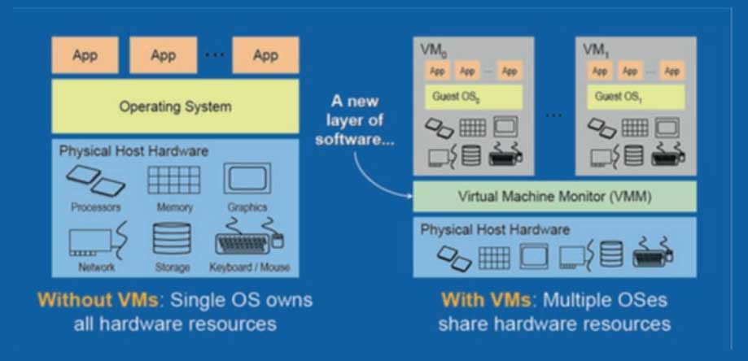
Operating System And virtualizations Architectures

Slide 14
Benefits Of Virtualization
More flexible and efficient allocation of resources.
Enhance development productivity.
It lowers the cost of IT infrastructure.
Remote access and rapid scalability.
High availability and disaster recovery.
Pay peruse of the IT infrastructure on demand.
Enables running multiple operating systems.

Slide 15
Linux Operating System Virtualization
Vmware workstation software is used to do the virtualization of Operating System.
For installing any Operating System virtually, you need to install VMware software.
We are using VMware workstation.
Before installing linux OS, you need to have iso image file of linux OS.
Let's see the steps to install the linux os virtually.

Slide 16

Containerization
Containerization is a operating system virtualization in which application can run in isolated user spaces called containers.
Everything an application needs is all its libraries , binaries ,resources , and its dependencies which are maintained by the containers.

Slide 17
Containers
Containers are packages of software that contain all of the necessary elements to run in any environment.
Containers virtualize the operating system and run anywhere.
  Like private data center.
  Public cloud.
  even on personal laptop.

Slide 18
Containers Tools
Docker
Kubernetes

Slide 19
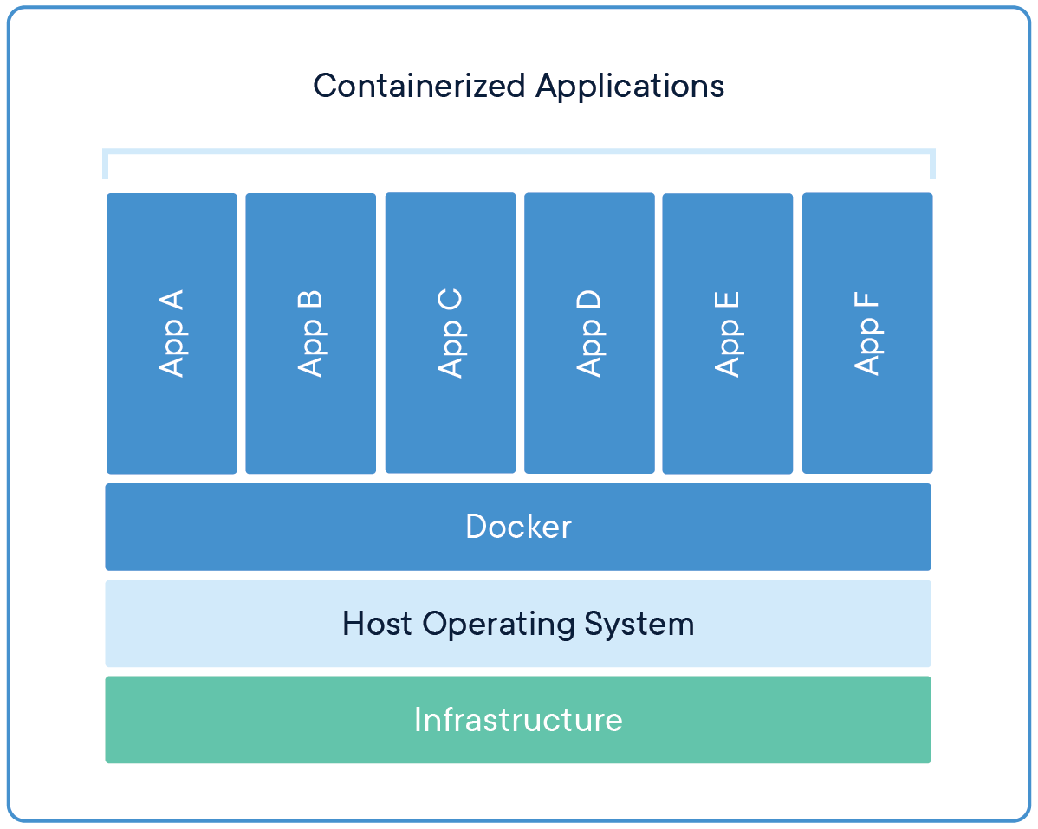
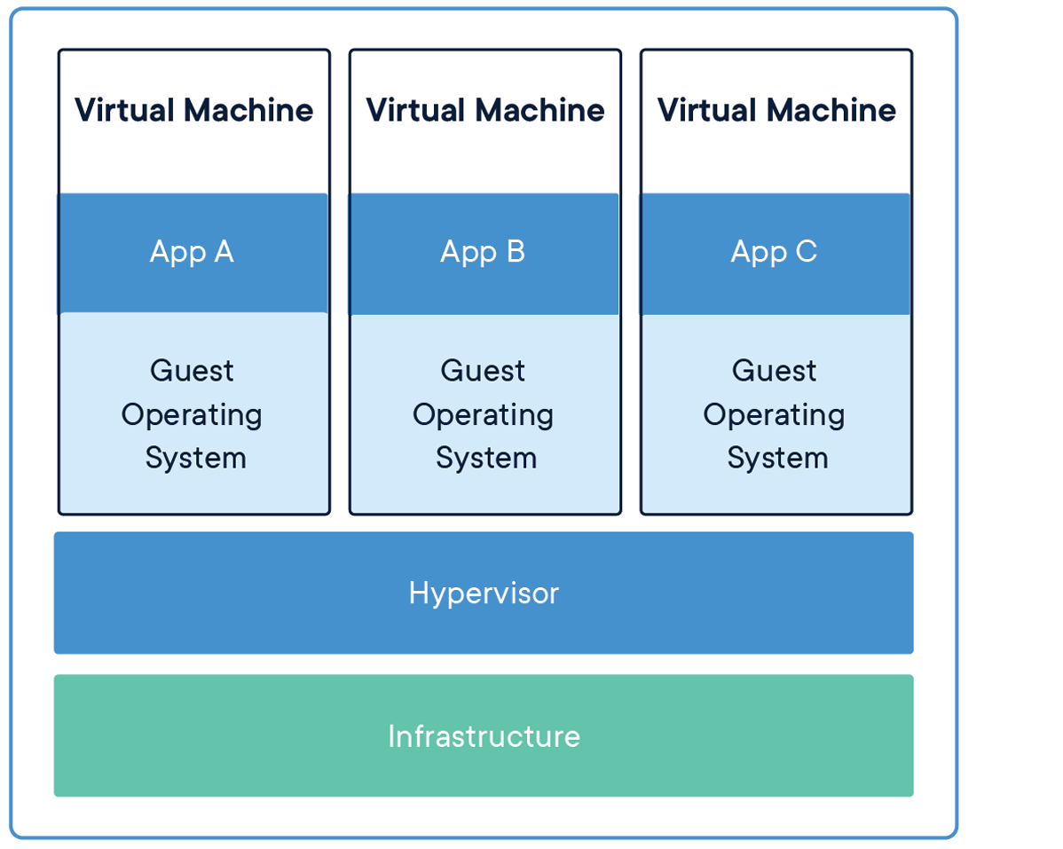
Containers vs Virtual Machines

Slide 20
Containers VS Virtual Machines (Cont.)
Containers | Virtual Machines
Containers are an abstraction at the app layer (OS level) that packages code and dependencies together | Virtual machines (VMs) are an abstraction of physical hardware turning one server into many servers (Hardware level).
Containers are much more lightweight than VMs | VM not lightweight.
Multiple containers can run on the same machine and share the OS kernel with other containers, each running as isolated processes in user space. | The hypervisor allows multiple VMs to run on a single machine.
Can handle more applications | Each VM includes a full copy of an operating system, the application, necessary binaries and libraries
Containers take up less space than VMs. Container images are typically 10MBs in size. | Taking up 10 GBs space. VMs can also be slow to boot.

Slide 21
Summary
Cloud Computing Architecture
  Front End, Back-end
Virtualization
  A technique, which allows to share a single physical instance of a resource in multiple customers and organizations.
Hypervisor
  Vmware workstation
Containerization
Containers VS Virtual Machines

